Slide 1
Screenless Displays: The Future of Visual Interaction
1RV23MC080
Rajesha C U
Under the Guidance
Of
Dr. Deepika K
Associate Professor
Department of MCA
Date :18/06/2025 Department of MCA, RVCE 1/12

Slide 2
Agenda
Introduction
Literature Survey
Summary of Literature Survey
Objectives
Technical Relevance
Block diagram of the Proposed work
References
2/12

Slide 3

Introduction
Screenless display technology delivers digital visuals without physical screens using AR, holography, and retinal projection.
It enables immersive, hands-free interaction, blending digital content with the physical world.
Key applications:
Healthcare – real-time data during surgery.
Education – 3D interactive learning.
Defense – AR-assisted mission data.
Entertainment & Wearables – smart lenses, gaming.
3/12

Slide 4
Literature Survey
Sl No | Author (s) & Paper title | Details of Publication | Summary of the Paper
1 | Yuta Itoh et al. – Slim Diffractive Waveguide Glasses for Beaming Displays with Enhanced Head Orientation Tolerance | In Proc. of IEEE Conference on Virtual Reality and 3D User Interfaces (IEEE VR), Saint‑Malo, France, 8–12 Mar 2025, pp. 351–358, | Presents slim diffractive‑waveguide AR glasses that improve angle tolerance for beamed displays, extending head orientation range from ~5° to ~20–30° while maintaining compactness.
2 | Hiroto Aoki, Takumi Tochimoto, Beaming Displays: Dual Steering Projectors for Extended Projection | IEEE Trans. Vis. Comput. Graph., vol. 30, no. 5, pp. 2309–2318, May 2024, | Describes a dual‑projector beaming display system that enables wider projection volumes and head pose ranges, achieving ~1.8–5.7 mm accuracy and ~14 ms latency at 1 m.
3 | Ippei Suzuki, Yuta Itoh & Yoichi Ochiai – A Retinal Projection– | In Springer LNCS: Human-Computer Interaction: Technological Innovation, HCII 2022, pp. | Proposes an integrated retinal‑projection viewfinder for cameras that delivers high-resolution imagery via passive optics in a minimal form factor.
4 | Make Your Own Retinal Projector via Metamaterials | ACM SIGGRAPH Emerging Technologies 2018, Article No., published Aug 2018 | Demonstrates a passive metamaterial‑based retinal display that bypasses conventional eye-lens systems, suggesting scalable wearable architectures.
5 | Facebook Reality Labs – Retinal Image Quality in Near‑Eye Pupil‑Steered Systems | SPIE proceedings (circa 2020), eye‑tracking & pupil‑steered near‑eye display context | Investigates the use of pupil‑steering in scanning retinal displays to maintain visual clarity across a wide field of view.
4/12

Slide 5
Sl No | Author (s) & Paper title | Details of Publication | Summary of the Paper
6 | Cheng‑Ting Huang & Hong Hua – Viewing Window Extension in Integral Imaging Based Head‑Mounted Light Field Display | SID Display Week Technical Symposium 2023 (IEEE-affiliated), published 2023 | Uses time‑multiplexed layered liquid crystal shutters in light‑field displays to expand viewing window and improve parallax in HMDs without glasses.
7 | Linghui Rao et al. – Infinite Display for Meta Quest Pro | SID Display Week 2023 session on AR/MR displays, published 2023 | Introduces microLED and polarization‑engineering methods to achieve high‑contrast near‑eye visuals in MR/AR headsets.
8 | Qian Yang et al. – Foveated AR Displays Based on Polarization‑Selective Flat Lenses | SID Display Week 2023, published 2023 | Presents polarization‑selective flat‑lens optics enabling foveated rendering and large eyebox in compact AR eyepiece designs.
9 | Ajay Mane & Pratibha Adkar – Unleashing the Future of Display Technology: A Comprehensive Study on Screenless Displays and Their Types | IJSREM, vol. X, issue Y, June 2023 | Surveys different screenless display types—including retinal, holographic, and light‑field systems—providing taxonomy and comparative analysis.
10 | Hassan et al. – Retinal Disease Projection Conditioning by Biological Traits | Complex & Intelligent Systems, vol. X, no. Y, 2024 | Examines how biological and retinal health factors influence projection‑based display ergonomics and custom calibration.
5/12

Slide 6
Summary of the literature survey
The reviewed papers cover advancements in screenless display technologies, including holography, volumetric video, retinal projection, and light field displays. Key innovations include glasses-free micro-LED displays, high-fidelity holography, and laser-based interaction systems. Several works focus on user immersion, clarity, and real-time rendering, while others provide comprehensive surveys of current technologies. However, common limitations across these studies include high computational cost, hardware complexity, scalability issues, and a lack of long-term validation or practical implementations. Many are still in the experimental stage, signaling the need for further development and testing before commercial application.
6/12

Slide 7
Objectives
To understand the core concept and working of screenless display technology
To explore its key enabling technologies like AR, holography, and retinal projection
To identify real-world applications across healthcare, education, defense, and entertainment
To examine future possibilities and emerging trends
To analyze the key advantages and challenges
8/12

Slide 8
Technical Relevance
Technical Relevance
Eliminates the need for physical screens in VR/AR headsets, holograms, retinal projection, smart glasses, voice interfaces.
Supports immersive technologies like AR/VR.
Enables hands-free and portable visual interfaces.
Useful in smart glasses, medical imaging, military and automotive displays.
Key Technical Features
Retinal projection: Displays visuals directly to the eye.
Holographic rendering: Creates 3D images with depth perception.
Volumetric display: Projects visuals into free space.
9/12

Slide 9
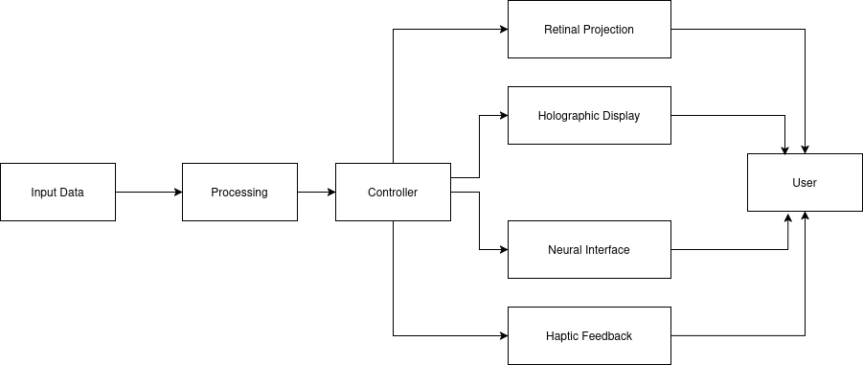
Block Diagram
10/12

Slide 10
References
[1] Z. Liu et al., "Holographic Video Communications," IEEE Wireless Communications, vol. 32, no. 2, Feb. 2025.
[2] T. Wang, C. Yang, J. Chen, Y. Zhao, J. Zong, et al., "Naked-eye light field display technology based on mini/micro LED panels: a systematic review and meta-analysis," Scientific Reports, vol. 14, Art. 24381, Oct. 2024.
[3] M. Rutz et al., "Perceived brightness and resolution in retinal scan glasses," arXiv:2403.xxxxx, Jul. 2024.
[4] Y. Jin et al., "Volumetric 3D video: capture, compression, display," arXiv:2404.xxxxx, Apr. 2024.
[5] PointerVol Team, "PointerVol: laser-pointer interaction in volumetric displays," ACM SIGGRAPH, 2024.
[6] K. Akşit and Y. Itoh, "HoloBeam: paper-thin near-eye displays," arXiv:2212.xxxxx, Dec. 2022.
[7] P. Chakravarthula et al., "Gaze-contingent retinal speckle suppression for foveated holographic displays," arXiv:2111.xxxxx, Nov. 2021.
[8] M. J. Jeong et al., "Screenless Display for Interactive Applications," Applied Sciences, vol. 11, no. 1, p. 117, Jan. 2021.
[9] W. Song et al., "Large-scale Huygens metasurfaces for holographic near-eye displays," arXiv:2010.xxxxx, Oct. 2020.
[10] P. S. Bhosale, R. Kale, and P. P. Salve, "Screenless Display: A Review," IJSRCSEIT, vol. 8, no. 1, pp. 337-343, 2022.
[11] V. Kumar, "Screenless Display Technology," SlideShare, 2024.
[12] M. Mierse, “Build a Sci-Fi aerial display,” IEEE Spectrum, Oct. 20, 2024. [Online]. Available: https://spectrum.ieee.org/diy-scifi-aerial-display.
11/12

Slide 11
[13] Virtual retinal display, Wikipedia, The Free Encyclopedia, 2025. [Online]. (Accessed: Jun. 12, 2025).
[14] M. J. Jeong et al., “Screenless display for interactive applications,” Appl. Sci., vol. 11, no. 1, p. 117, 2021.
[15] H. Fuchs et al., “A survey of techniques for 3D display,” Comput. Graph. Forum, vol. 25, no. 4, pp. 1105–1126, 2006.
[16] X. Yang et al., “Progress in volumetric 3D display technologies,” IEEE Access, vol. 8, pp. 98661–98673, 2020.
[17] J. S. Kim et al., “Review of holographic 3D display technologies,” J. Korean Phys. Soc., vol. 63, no. 1, pp. 11–20, 2013.
[18] M. Lucente et al., “A survey of light-field displays,” Proc. IEEE, vol. 101, no. 7, pp. 1469–1487, 2013.
[19] H. Kuwahara et al., “Three-dimensional displays: Technologies and applications,” Proc. IEEE, vol. 101, no. 7, pp. 1508–1523, 2013.
[20] H. Saito et al., “Laser-plasma scanning 3D display for putting digital contents in free space,” Proc. SPIE, vol. 6803, Feb. 2008, doi:10.1117/12.768068.
[21] K. Unagar, “Screenless display (1),” SlideShare, 2024. [Online]. Available: https://www.slideshare.net/slideshow/screenless-display-204907143/204907143.
[22] K. Kumagai and Y. Hayasaki, “Colored voxels of laser-excited aerial volumetric display,” in Digital Holography and 3-D Imaging 2022, D. Chu et al., Eds., OSA Technical Digest (online), paper W3A.1, 2022, doi:10.1364/DH.2022.W3A.1.
[23] K. Kumagai, S. Miura, and Y. Hayasaki, “Aerial re-imaging of femtosecond-laser-excited graphics for volumetric display,” in OSA Imaging and Applied Optics Congress (Imaging, 3D, DH, ISA, COSI), OSA Technical Digest, paper 3Th7E.1, 2021.
[24] W. D. Jones, “Wireless display on a contact lens,” IEEE Spectrum, Nov. 2011.
[25] E. N. Sardinha, M. Munera, N. Zook, D. Western, and V. Ruiz Garate, “Diegetic graphical user interfaces and intuitive control of assistive robots via eye-gaze,” arXiv:2401.03944 [cs.RO], 2024.
12/12

